Slide 1
Imperative Data Parallelism (Correctness)
Unit 1.b

Slide 2
Acknowledgments
Authored by
Thomas Ball, MSR Redmond

Slide 3
Concepts
Code
Concept
Parallel.Invoke
Parallel.ForEach
Schedules and determinism
Assertions/Invariants
Unit Testing
Correctness
Concept

Slide 4
Parallel.Invoke
static void Invoke(params Action[] actions);
int x = 0;
Parallel.Invoke(
() => { x=1; },
() => { x=2; }
);
Console.WriteLine(“x={0}”, x);
Alpaca
Project
ParallelSamples.cs

Slide 5
Parallel DAG and Happens-before Edges
x=0
x=1
x=2
WriteLine(x)

Slide 6
Schedule, Informally
A topological sort (serialization) of the nodes
in a parallel DAG
-
A sequential ordering of the nodes that
respects the happens-before edges

Slide 7
Different schedules, different outputs
x=0
x=0
x=1
x=2
x=2
x=1
WriteLine(x)
WriteLine(x)
x = 2
x = 1

Slide 8
Determinism
For the same initial state,
observe the same final state,
regardless of the schedule
Determinism desirable for most data-parallel problems

Slide 9
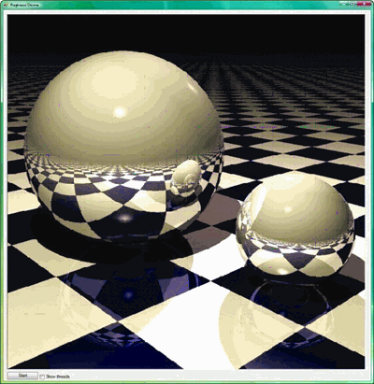
Parallel Ray Tracing: Deterministic
void Render(Scene scene, Color[,] rgb)
{
Parallel.For(0, screenHeight, (y) =>
{
for (int x = 0; x < screenWidth; x++)
{
rgb[x,y] = TraceRay(new Ray(scene,x,y));
}
});
}

Slide 10
Unit Testing
The goal of unit testing is to isolate each part of the program and show that the individual parts are correct
A unit test is
a closed program that
sets up conditions to run
a program unit and
check the results

Slide 11
System vs. Unit Testing
System Testing
Test entire application
Needed to find integration errors
Does not put much stress on individual components
Unit Testing
Better coverage, but more work
Necessity for libraries and frameworks
Good idea for tricky parallel/concurrent components

Slide 12
Checking Determinism
How can we test the correctness of the parallel Ray Trace application?
Create unit test to compare
the parallel version
the sequential version
Should we be satisfied with such tests?
Do unit tests work well for parallel programs?
Alpaca
Project
RayTracerTest.cs

Slide 13
IEnumerable and Parallel.ForEach
Parallel.ForEach is not limited to integer ranges and arrays!
Generic enumerations
IEnumerable<T>
Lists, sets, maps, dictionaries, …
Notes:
Works for generics only.

Slide 14
Parallel.ForEach
public static ParallelLoopResult
ForEach<TSource>(
IEnumerable<TSource> source,
Action<TSource> body
);

Slide 15
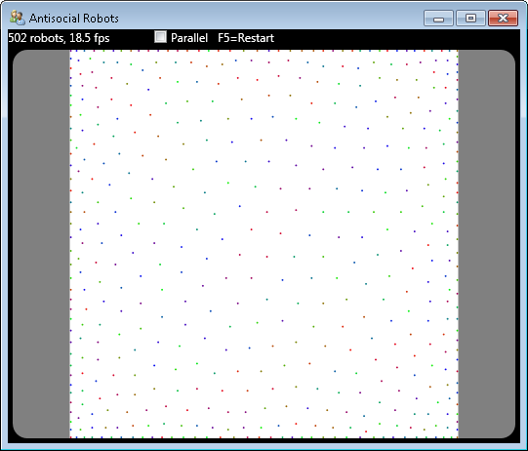
Speedup Demo: Antisocial Robots
fps
=
frames
per
second

Slide 16
Speedup: Over 3x on a 4-core!

Slide 17
The Difference in the Code?
void PerformSimulationStep()
{
if (naiveparallel.IsChecked.Value)
{
_robotSim.ParallelStep();
}
else
{
_robotSim.SequentialStep();
}
. . .
public void SequentialStep()
{
foreach (Robot robot in _robots)
SimulateOneStep(robot);
}
public void ParallelStep()
{
Parallel.ForEach(_robots, r =>
SimulateOneStep(r));
}

Slide 18
Key Data Structures
struct RoomPoint {
public int X;
public int Y;
}
class Robot {
public RoomPoint Location;
}
List<Robot> _robots;
Robot[][] _roomCells;
(0,0)
 | r1
 |  | r2
_roomCells;

Slide 19
SimulateOneStep(Robot r1)
Determine new cell for r1
Move r1 to new cell, if not already occupied
 | r1
 |  | r2
r1
 |  | r2

Slide 20
 | 0 | 1 | 2 | 3 | 4
0 | r | r |  | r | r
1 | r | r1 |  | r2 | r
2 | r | r | r | r | r
PerformSimulationStep
PerformSimulationStep
 | 0 | 1 | 2 | 3 | 4
0 | r | r | r1 | r | r
1 | r |  |  | r2 | r
2 | r | r | r | r | r
 | 0 | 1 | 2 | 3 | 4
0 | r | r | r2 | r | r
1 | r | r1 |  |  | r
2 | r | r | r | r | r
Notes:
Non-determinism is acceptable in anti-social robots.

Slide 21
 | 0 | 1 | 2 | 3 | 4
0 | r | r |  | r | r
1 | r | r1 |  | r2 | r
2 | r | r | r | r | r
 | 0 | 1 | 2 | 3 | 4
0 | r | r | r2 | r | r
1 | r |  |  |  | r
2 | r | r | r | r | r
Notes:
But this is not acceptable.

Slide 22
Pigeonhole Principle
“Two robots can’t occupy the same cell”
If it is true before execution of
PerformSimulationStep
then it should be true afterward, regardless of
sequential/parallel implementation
foreach (var in _robots)
Debug.Assert(_roomCells[r.Location.X,r.Location.Y] == r,
“Can’t have two robots in the same cell!”);

Slide 23
Assert Statement
Assert(e)
e a Boolean expression (state predicate)
e should always evaluate true when statement executes; otherwise program has an error
Helpful assertions have messages:
Assert(balance>=0,
“account balance should be non-negative”)

Slide 24
Invariant
State predicate e is invariant to program fragment S provided that
If predicate e is true before execution of S then
Then predicate e is true after execution of S
So,
State predicate
“Two robots can’t occupy the same cell”
Is invariant to
PerformSimulationStep

Slide 25
AntisocialRobots.csproj
1. Antisocial Robots has a Bug
2. It’s Hard to Expose Concurrency Bugs!
Notes:
First, run the application and choose a board size of 20x20.
Now, enable parallelism and checking. Play around for a while. Use F5 to reset the board.
Try to get the error message dialog to pop up.
Then use the Alpaca test instead.

Slide 26
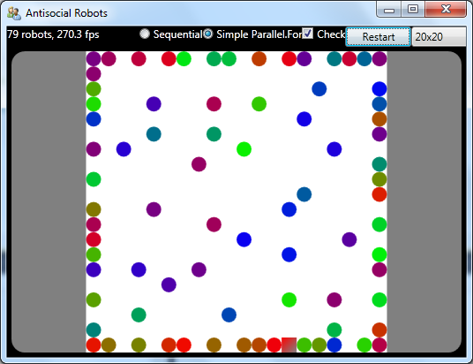
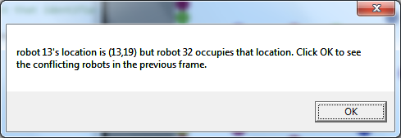

Slide 27
Run Alpaca [UnitTestMethod]
to get more reliable
reproduction of bug
Alpaca
Project
RobotSimulationInterferenceTest.cs
Notes:
First, run the application and choose a board size of 20x20.
Now, enable parallelism and checking. Play around for a while. Use F5 to reset the board.
Try to get the error message dialog to pop up.
Then use the Alpaca test instead.

Slide 28
High-level Problem
SimulateOneStep(r1) and SimulateOneStep(r2) interfere with one another when
r1 wants to move to cell (X,Y), and
r2 wants to move to cell (X,Y)
Sequential version: invariant is maintained
Parallel version: invariant breaks!

Slide 29
Two Bugs in Three Lines: Updating Robot r’s Location
SimulateOneStep(Robot r) {
RoomPoint ptR;
// compute new location of Robot r into ptR
...
// update robot location
if (((ptR.X != r.Location.X) || (ptR.Y != r.Location.Y))
&& (_roomCells[ptR.X, ptR.Y] == null))
{
_roomCells[r.Location.X, r.Location.Y] = null;
_roomCells[ptR.X, ptR.Y] = r;
r.Location = new RoomPoint(ptR.X, ptR.Y);
}

Slide 30
Order of Statements Leading to Invariant Failure
 | 0 | 1 | 2 | 3 | 4
0 | r | r |  | r | r
1 | r | r1 |  | r2 | r
2 | r | r | r | r | r
SimulateOneStep(r1)
SimulateOneStep(r2)
Time
if (_roomCells[2,0] == null)
_roomCells[1,1] = null;
_roomCells[2,0] = r1;
r1.Location = (2,0);
if (_roomCells[2,0] == null)
_roomCells[3,1] = null;
_roomCells[2,0] = r2;
r2.Location = (2,0);

Slide 31
Order of Statements Leading to Invariant Failure
 | 0 | 1 | 2 | 3 | 4
0 | r | r | r2 | r | r
1 | r |  |  |  | r
2 | r | r | r | r | r
SimulateOneStep(r1)
SimulateOneStep(r2)
if (_roomCells[2,0] == null)
_roomCells[1,1] = null;
_roomCells[2,0] = r1;
r1.Location = (2,0);
if (_roomCells[2,0] == null)
_roomCells[3,1] = null;
_roomCells[2,0] = r2;
r2.Location = (2,0);

Slide 32
Question: What is the Second Bug?
Think about the struct RoomPoint
Come up with a scenario
Ordering of statements leading to invariant violation

Slide 33
Parallel.For/ForEach and Correctness
No interference between delegates on different loop iterations
Avoid Writing to Shared Memory Locations
Avoid Calls to Non-Thread-Safe Methods
No interference: implies determinism?
Only the GUI thread can access GUI state
Don’t execute Parallel.For on the GUI thread
Notes:
Abstracting away from this detail: purity!!!

Slide 34
Parallel Programming with Microsoft .NET
Chapter 2 (Parallel Loops) Parallel.For/ForEach
Appendix B (Debugging and Profiling Parallel Applications)

